Slide 1



Why is it important to address cancer-related malnutrition and sarcopenia
?

Slide 2
Cancer-related malnutrition and sarcopenia
malnutrition
sarcopenia
A condition characterised by loss of weight, loss of muscle or low body mass index, plus reduced food intake/ assimilation or inflammation.
low muscle mass
A condition characterised by loss of skeletal muscle mass and strength with an impact on physical performance.
Allison SP. Nutrition 2000; 16(7-8): 590-3.
Cederholm T, et al., Clin Nutr. 2019 Feb;38(1):1-9
Cruz-Jentoft AJ et al., Age Ageing. 2019 Jul 1;48(4):601
Notes:
Malnutrition is a condition characterised by loss of weight, loss of muscle or low body mass index, plus reduced food intake/ assimilation or inflammation.
Sarcopenia is a condition characterised by loss of skeletal muscle mass and strength with an impact on physical performance.
Low muscle mass is a common factor across both malnutrition and sarcopenia

Slide 3

Cancer-related malnutrition and sarcopenia
1in 3
people with cancer are
malnourished or sarcopenic
Notes:
Malnutrition and sarcopenia are common conditions, affecting approximately 1 in 3 people with cancer

Slide 4
Cancer-related malnutrition and sarcopenia
Cancer-related muscle loss develops up to
than age-related muscle loss
100 days of cancer treatment = ~ 20 years of ageing
10 x
faster
Bauer J, et al. J Cachexia Sarcopenia Muscle. 2019;10(5):956-61.
Muscaritoli M, et al. Intern Emerg Med. 2013;8(7):553-60.
Notes:
Cancer related muscle loss occurs rapidly.
In 100 days of cancer treatment, we can see muscle losses equivalent to that seen in 20 years of aging

Slide 5







Cancer-related malnutrition and sarcopenia
Early identification and treatment of malnutrition:
- improves quality of life and treatment outcomes
- is estimated to save $800K per 100,000 population
postoperative complications
dose-limiting toxicities
unplanned hospital admissions
length of stay
healthcare costs
quality of life
survival
Arends J et al., Clinical Nutrition 2007;36(1):11-48
Bruyere O et al., Maturitas 2019; 119: 61-69
Hebuterne X et al., JPEN 2014; 38(2): 196-204
Isenring E et al., Nut & Diet 2013; 70(4): 312-324
Marshall KM et al., Clin Nut 2019; 38(2): 644-651
Prado CMM et al., The Lancet Oncology 2008; 9(7): 629-35
Blauwhoff-Buskermolen S et al., J of Clinical Oncology 2016; 34(12): 1339-44
Prado CMM et al., Clinical Cancer Research 2009; 15(8): 2920-6
Elia M, British Association of Parenteral and Enteral Nutrition, 2015
Notes:
Malnutrition and low muscle mass are independent predictors of adverse clinical outcomes such as post-operative complications, treatment interruptions related to increased treatment toxicity, unplanned hospital admissions, an increased length of stay and increased cost to the health system. As well as reduced quality of life and reduced overall survival
Early identification and treatment of malnutrition mitigates these adverse outcomes and is estimated to save the health system $800K per 100,000 population
This highlights the need for models of care that support early identification and treatment of BOTH malnutrition AND sarcopenia to improve clinical outcomes in people with cancer.

Slide 6
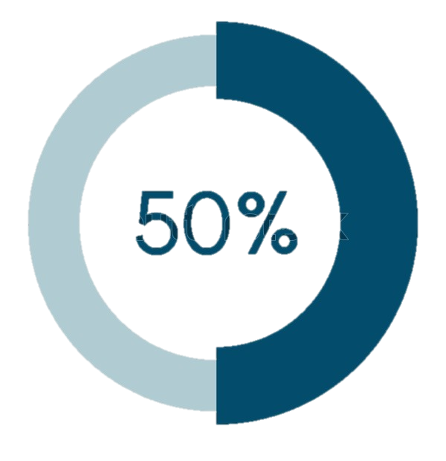
Cancer-related malnutrition and sarcopenia
Nutrition should be a key component of cancer care
Patients and carers report a high interest and need for nutrition care
However, access to nutrition care and information is limited
only 50% of people with cancer who are malnourished are under the care of a dietitian
Loeliger J et al. Support Care Cancer. 2021 Sep;29(9):5475-5485.
Baguley BJ et al. J Cancer Surviv. 2024;18:176–185.
Maschke J et al. Int J Clin Oncol. 2017 Feb;22(1):200-206.
Sullivan ES et al. Clin Nutr ESPEN. 2021 Feb;41:331-339.
Steer B et al., 2024 Cancer Malnutrition Point Prevalence Study Summary Report, VCMC
Notes:
Despite a strong evidence base relating to cancer-related malnutrition, we know that gaps in nutrition care remain
Multiple evidence-based guidelines indicate nutrition care should be a key component of cancer care
Patients and carers believe nutrition is important, reporting high interest and need for nutrition care
However, access to nutrition care and information is limited
Data from the 2024 Victorian cancer malnutrition point prevalence study, found that approximately 50% of patients with malnutrition were not under the care of a dietitian.

Slide 7
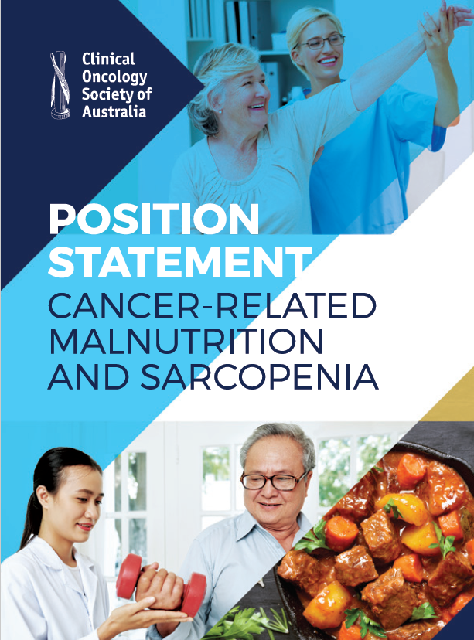
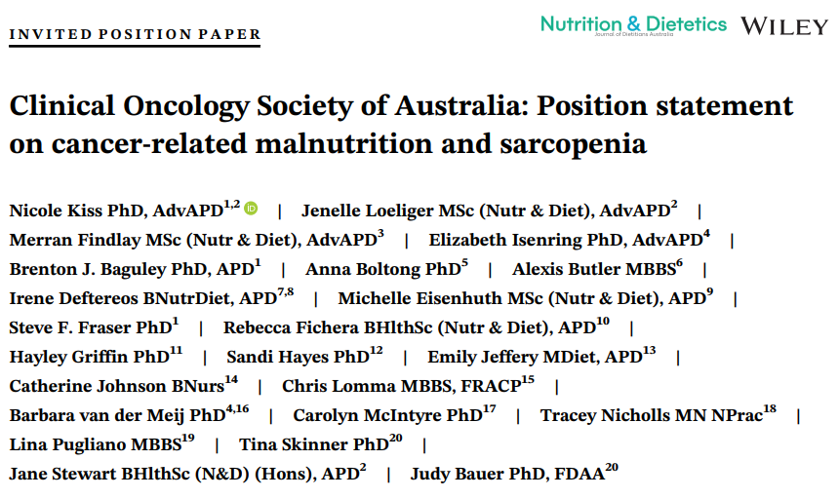
COSA position statement
Nutrition & Dietetics paper available open access:
https://onlinelibrary.wiley.com/doi/10.1111/1747-0080.12631
Position statement available at:
https://www.cosa.org.au/publications/position-statements/
Notes:
The COSA position statement on cancer related malnutrition and sarcopenia was released in 2020

Slide 8
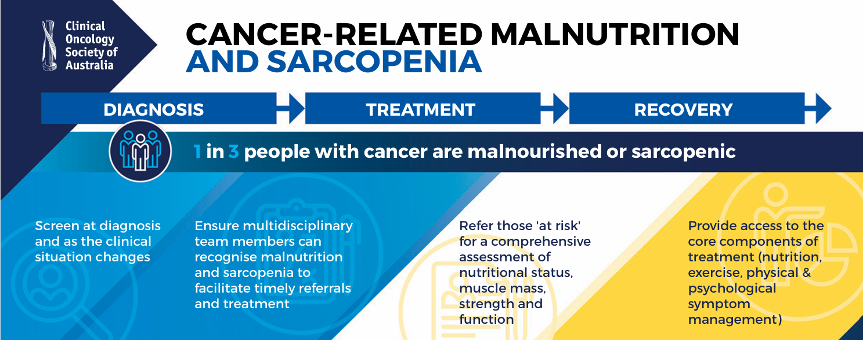
COSA position statement
Notes:
The position statement encourages clinicians to consider malnutrition and sarcopenia across the continuum of care and provides 9 x evidence-based recommendations addressing screening, assessment, treatment and the role of the multidisciplinary team

Slide 9
Cancer-related malnutrition and sarcopenia
Adherence to position statement recommendations:
Malnutrition
Screening met/partially met/not met
Referral met/partially met/not met
Assessment met/partially met/not met
Treatment met/partially met/not met
Multidisc Care met/partially met/not met
Sarcopenia
Screening met/partially met/not met
Referral met/partially met/not met
Assessment met/partially met/not met
Treatment met/partially met/not met
Multidisc Care met/partially met/not met
Notes:
Add your local audit data here:
You could also add local data relating to prevalence of malnutrition or sarcopenia and what proportion of these are under the care of Dietitians or Physiotherapy/Exercise Physiologist

Slide 10
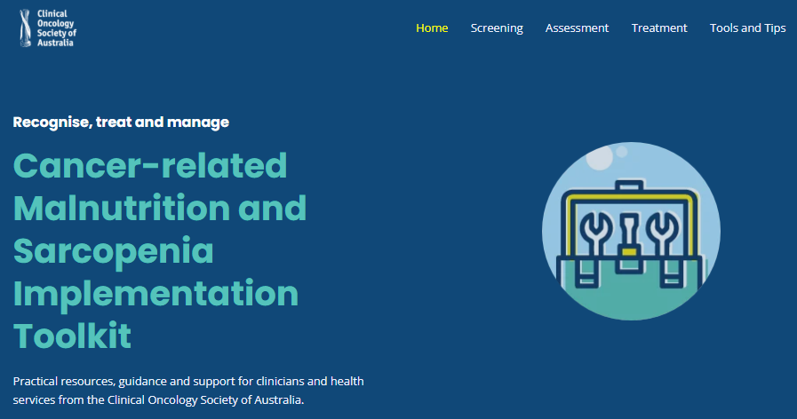




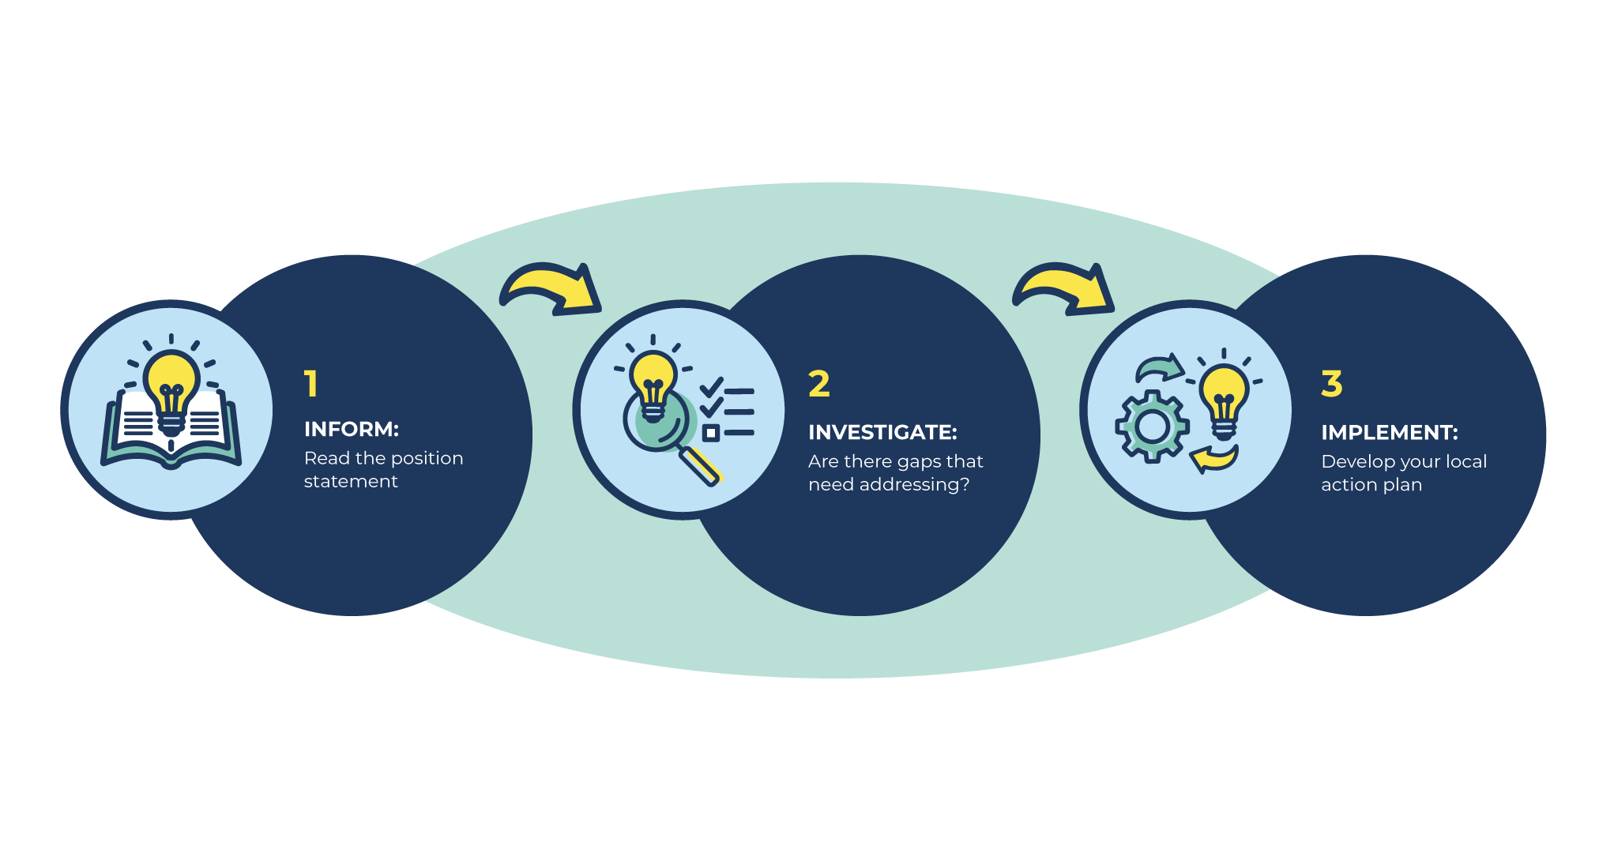


COSA Implementation Toolkit
Screening
Malnutrition & sarcopenia screening tools
Multidisciplinary Care
Importance of multidisciplinary care
Roles and responsibilities
Assessment
11 how-to guides
17 instructional videos
Transitions of Care
Importance of multidisciplinary care
Options for the care of cancer-related malnutrition & sarcopenia
Treatment
Core components
Online hub of EBGs & patient education material
4 clinical case studies
Tools and Tips
Develop your local action plan
Audit tool & self-assessment checklist
The ‘Why’ slide deck
How to build your implementation team
5 AACTT frameworks
Generic care pathway
Checklist to identify & address barriers
Example clinical indicators
20 exemplars of evidence-based care
https://cancermalnutritionandsarcopenia.org.au
Notes:
The COSA implementation toolkit has been developed to support implementation of the position statement recommendations into clinical practice
You can find a suite of practical resources to support screening, assessment, treatment, the role of the multidisciplinary team, transitions of care as well as resources to support implementation.

